Slide 1



Spotify & Youtube Songs Statistics FRANGI Francesco Frigato, Andrea Felline, Gianluca Antolini
Master’s Degree in Computer Engineering
Database 2 – Group Project - A.Y. 2023/23
Notes:
Intro

Slide 2

TOPIC
Spotify Songs
STREAMS, MUSIC INFO, ARTISTS, ALBUMS, PLAYLISTS,
…
Youtube Videos
VIEWS, LIKES, COMMENTS, CHANNELS,
…
Notes:
Topic is popular spotify songs (with all their related info) and their related youtube video

Slide 3





DATASETS
DATA CLEANING
Different timestamps, duplicate data, …
DATA MERGE
Id matching
DATA LOADING
Entities and data properties,
object properties linking
SERIALIZATION
Single Turtle (.ttl) file
Spotify and Youtube
Spotify songs
https://www.kaggle.com/datasets/salvatorerastelli/spotify-and-youtube
https://www.kaggle.com/datasets/sujaykapadnis/spotify-songs
Id Artist Url_spotify Track Album Album_type Uri Danceability Energy Key Loudness Speechiness Acousticness Instrumentalness Liveness Valence Tempo Duration_ms Url_youtube Title Channel Views Likes Comments Description Licensed official_video Stream
track_id track_name track_artist track_popularity track_album_id track_album_name track_album_release_date playlist_name playlist_id playlist_genre playlist_subgenre danceability energy. key loudness mode speechiness acousticness instrumentalness liveness valence tempo duration_ms
Notes:
Datasets from kaggle, 30.8 MB (about 20k rows) and 8 MB (28k rows), all the columns, some of them we removed

Slide 4
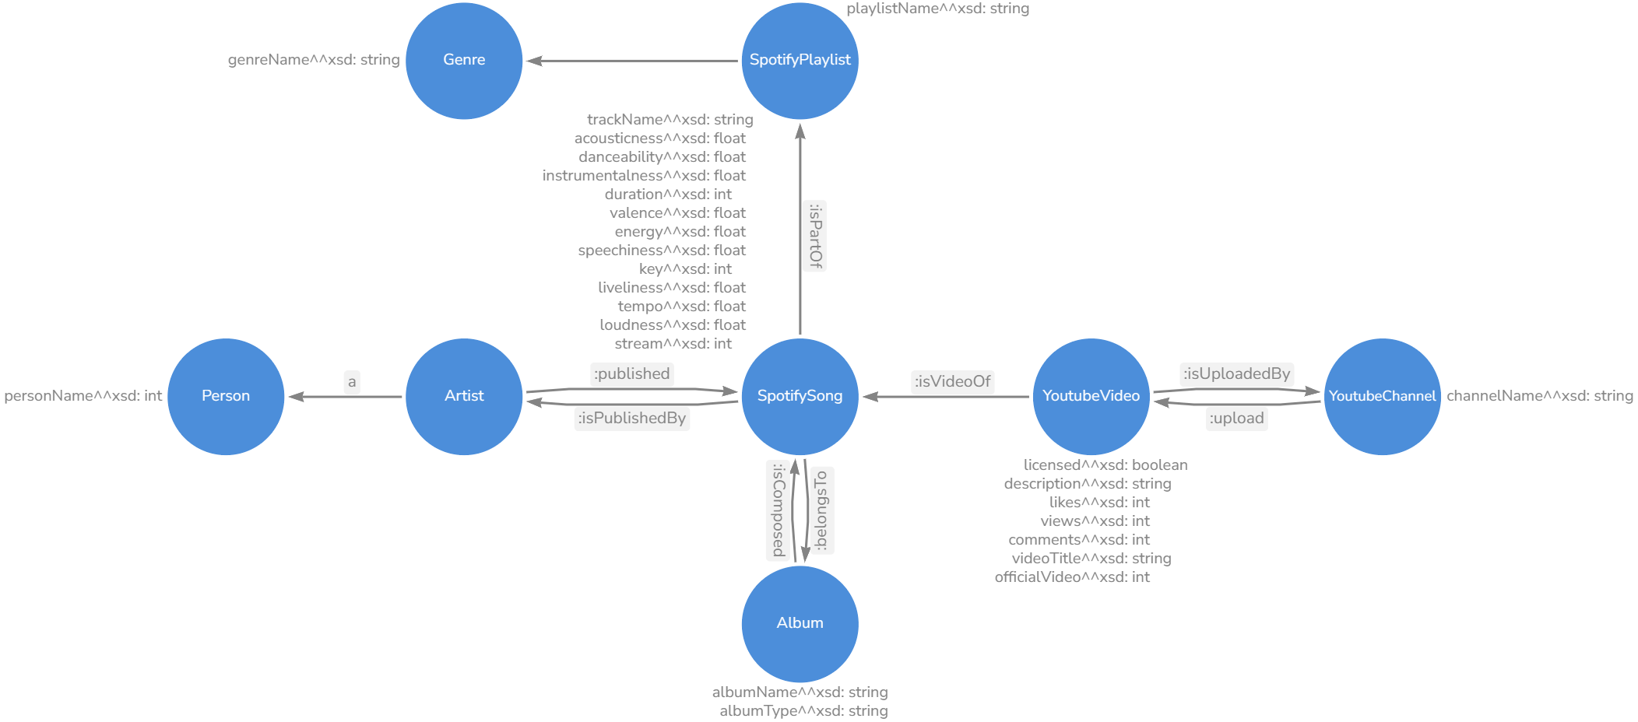
PIPELINE
DATA CLEANING
Different timestamps, duplicate data, …
DATA MERGE
Id matching
DATA LOADING
Entities and data properties,
object properties linking
SERIALIZATION
Single Turtle (.ttl) file
Notes:
Data Clean:
There may be multiple lines referring to the same song, for example if a song was made by multiple artists, each row should have the same values for everything except for the artist. Sometimes it happens that some values that should be the same, are actually different, probably as a conseguence of the fact that the data was taken in different moments and some value changed in the meanwhile. In particular the number of streams of a song has often different values in different rows, even if the song is the same. We keep the highest value since the number of stream is a monotonous increasing function of time (and thus the highest value is the most recent).
A similar resoning was made for the number of comments, likes, views and for the officiality of the video of a song. In this case we assumed that the row were in cronological order and we kept the last values (this assumption was mandatory since the most recent officiality value cannot be choosen as the other values).
We then merged the rows of the two database based on the track id (both datasets had it). One of the two datasets had the track id in the format "spotify:track:<id>" (for example "spotify:track:0d28khcov6AiegSCpG5TuT" while the other only had "<id>" (for example "0d28khcov6AiegSCpG5TuT") so we edited the first one in order to have the same format of the second one.
Data Load:
For each row of the merged dataset we create a node for each entity (based on the ontology), then we check whether the entity was already added to the graph and, if not, we add it and its data property. Once all the entities of a row are added, we link them (if they weren't already linked in a previous iteration).
At the end everything is serialized and saved in turtle format.

Slide 5
ONTOLOGY
Notes:
Main ontology schema, not too big but with all the essentials

Slide 6
ONTOLOGY
Notes:
Spotify song with all its info. Published by at least an Artist (wich is a subclass of Person) and viceversa. Can be part of a playlist, which has one or more genres. Genres modeled with skos (broader & narrower for subgenres)

Slide 7

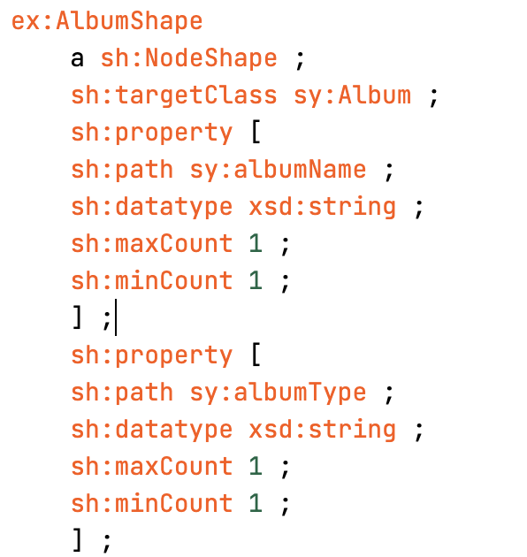
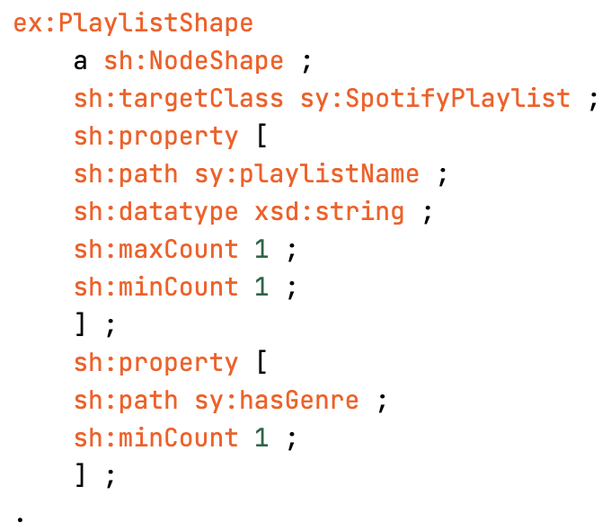
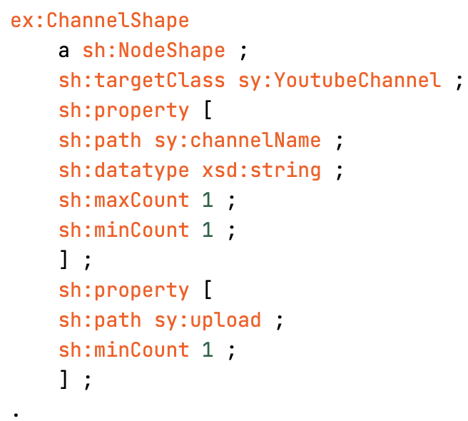
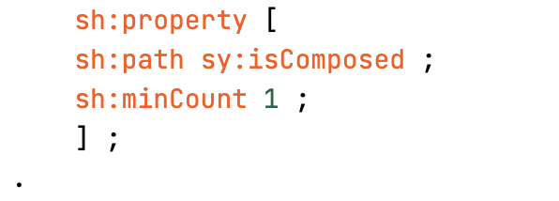
ONTOLOGY
Notes:
Song belongs to an album which can be of type single (so contains only the song), or album or compilation (both can contain more than 1 song). Song be song of a youtube video (all info about video), uploaded by specific channel.

Slide 8
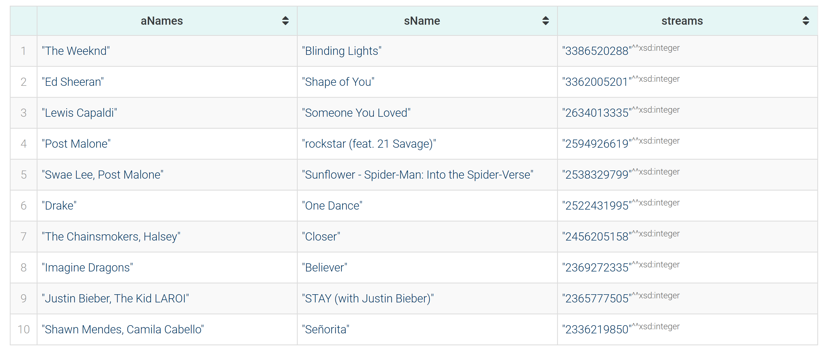
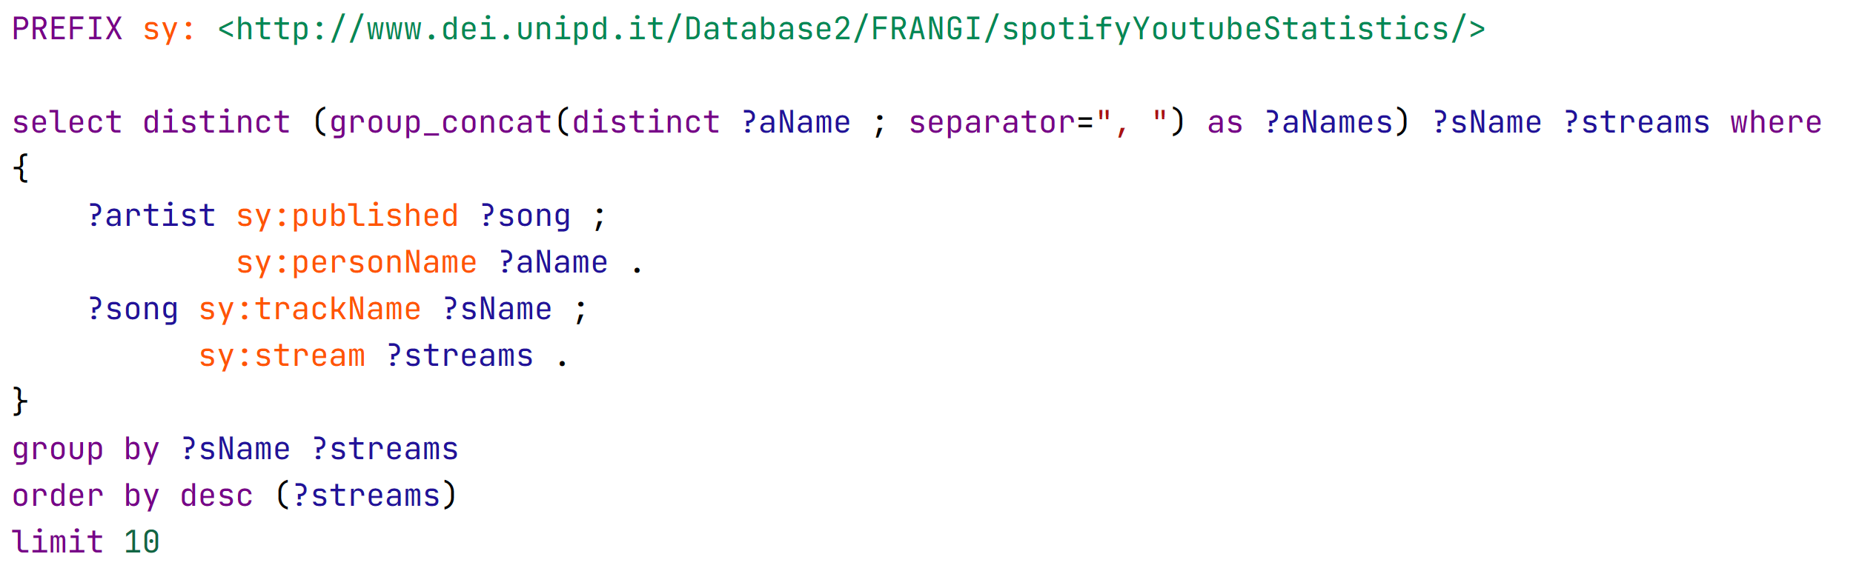
VALIDATION
Notes:
We tried validation with SHACL to make sure everything was correct and checked if there were any error that could have appeared during data cleaning, merging and loading.

Slide 9
QUERIES (1)
Top 10 songs by number of streams

Slide 10
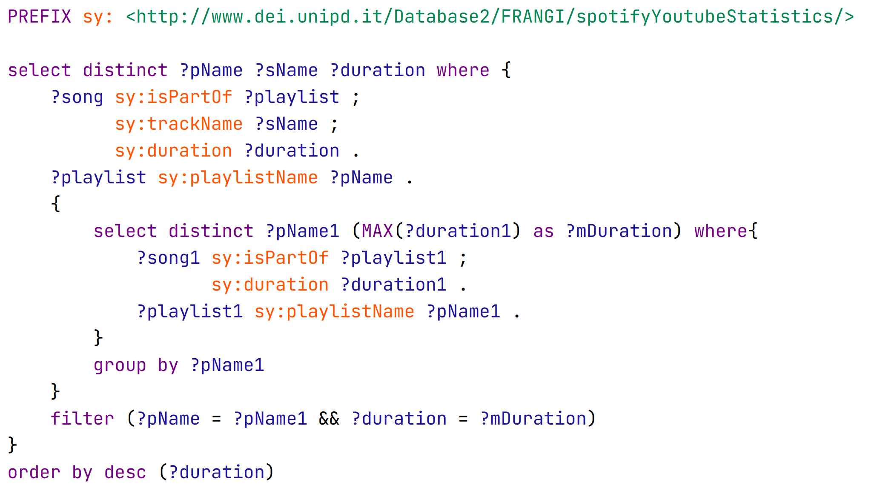
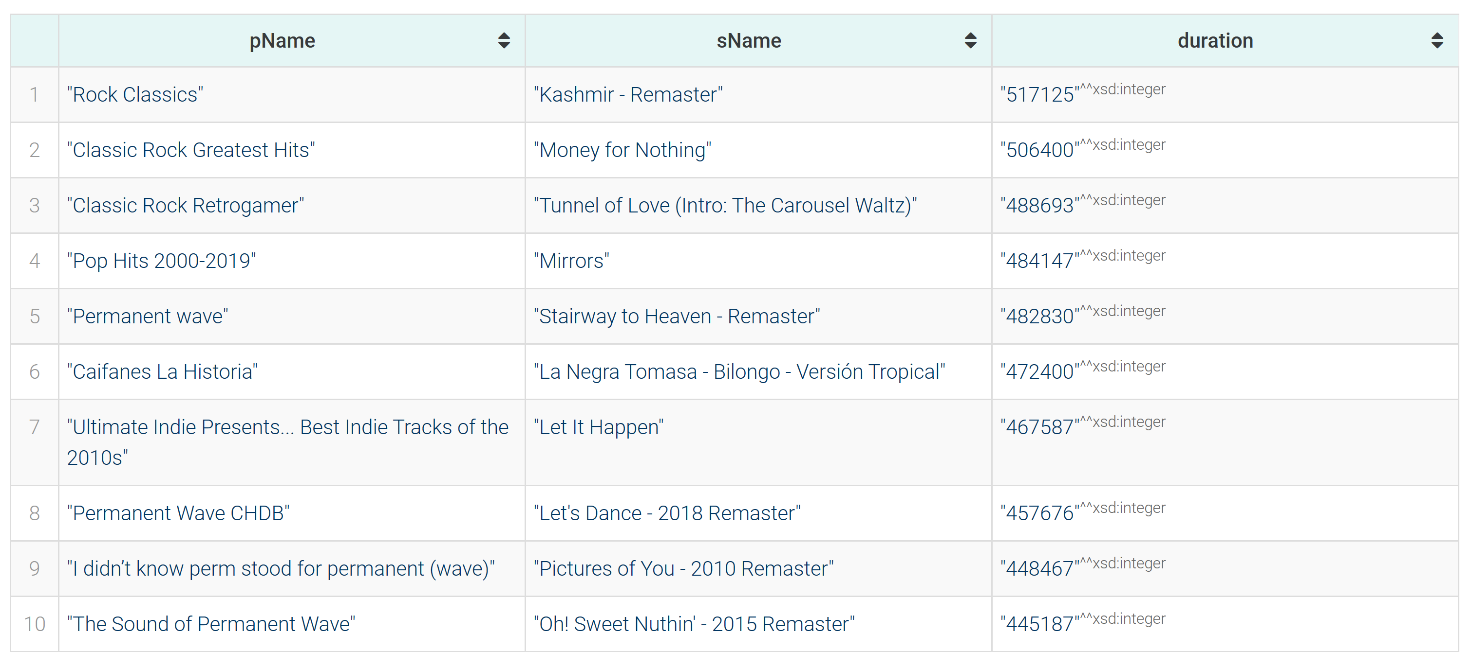
QUERIES (2)
Song with max duration for each playlist, ordered by duration

Slide 11
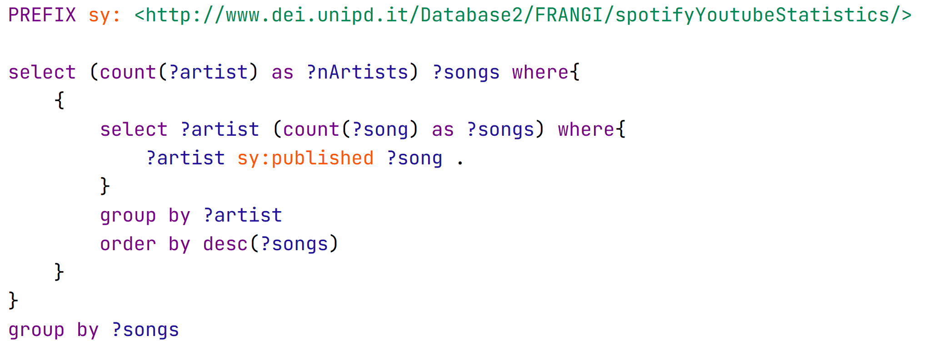
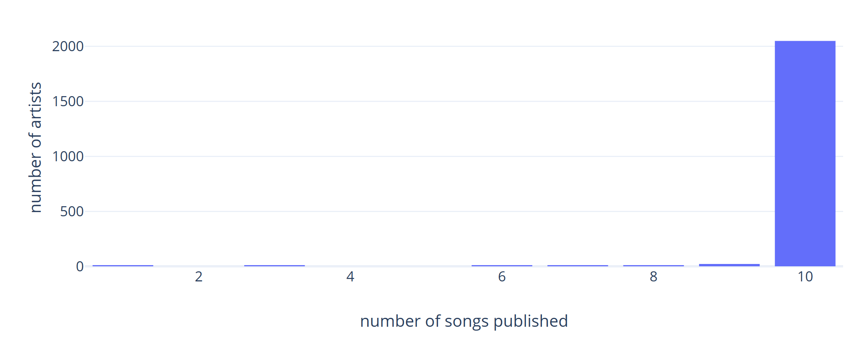
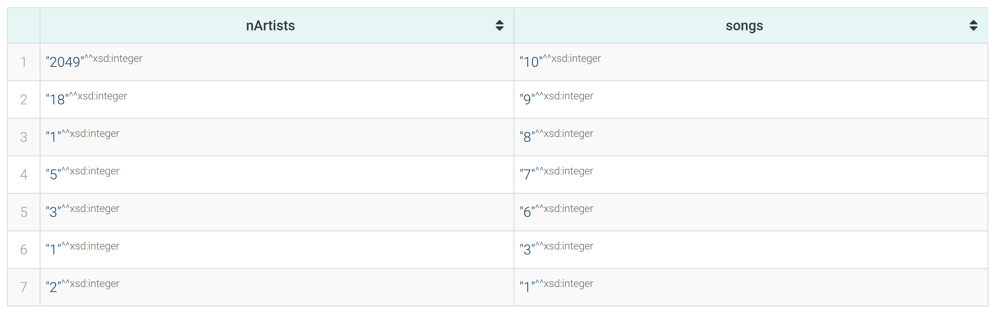
QUERIES (3)
How many artists published n songs
Notes:
Note discrepancy, maybe is because of the datasets we used.

Slide 12
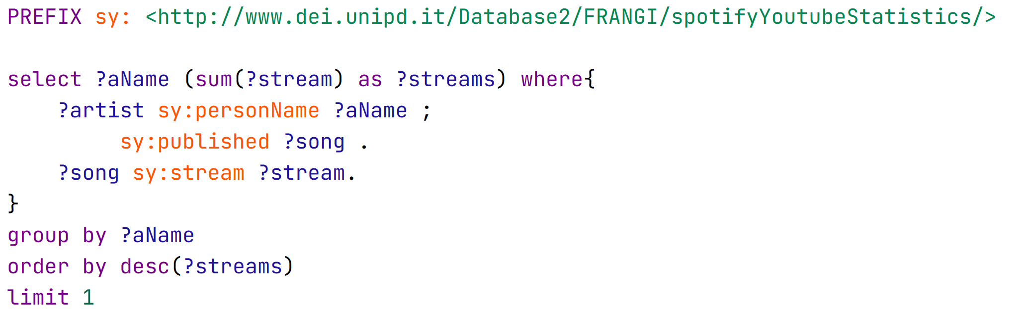

QUERIES (4)
Artist that produced the most streams

Slide 13
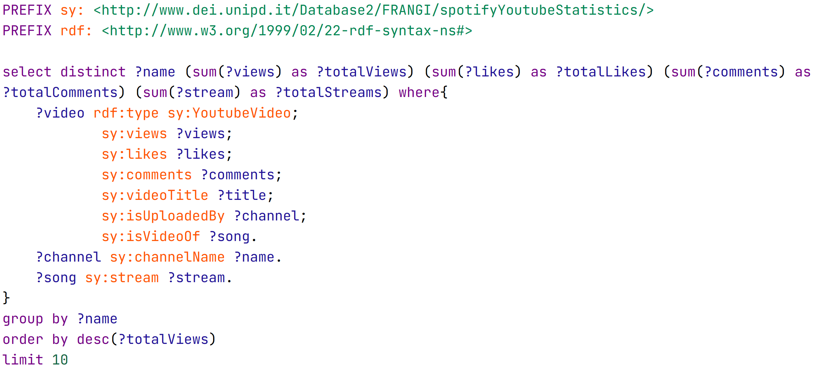
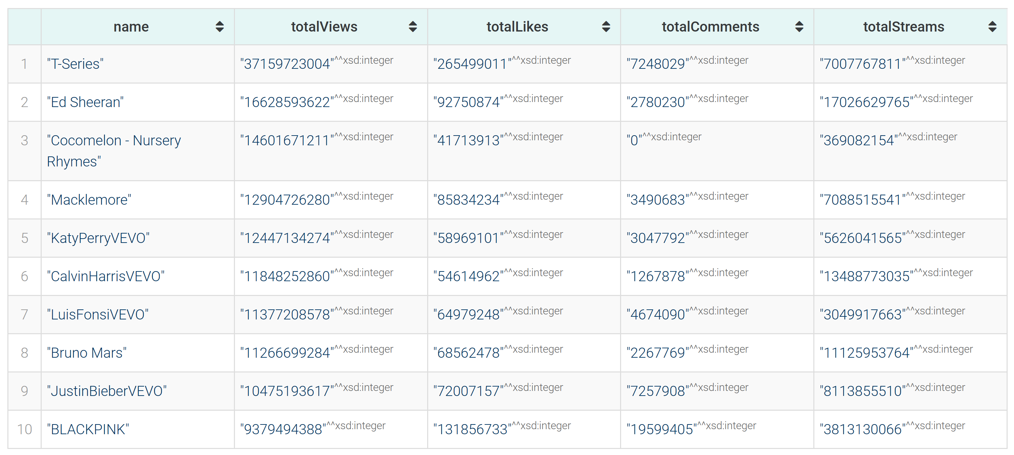
QUERIES (5)
Top 10 channels by number of views, with also likes and comments
Notes:
Turns out Indian music is very listened, also kids music, but they disabled comments

Slide 14
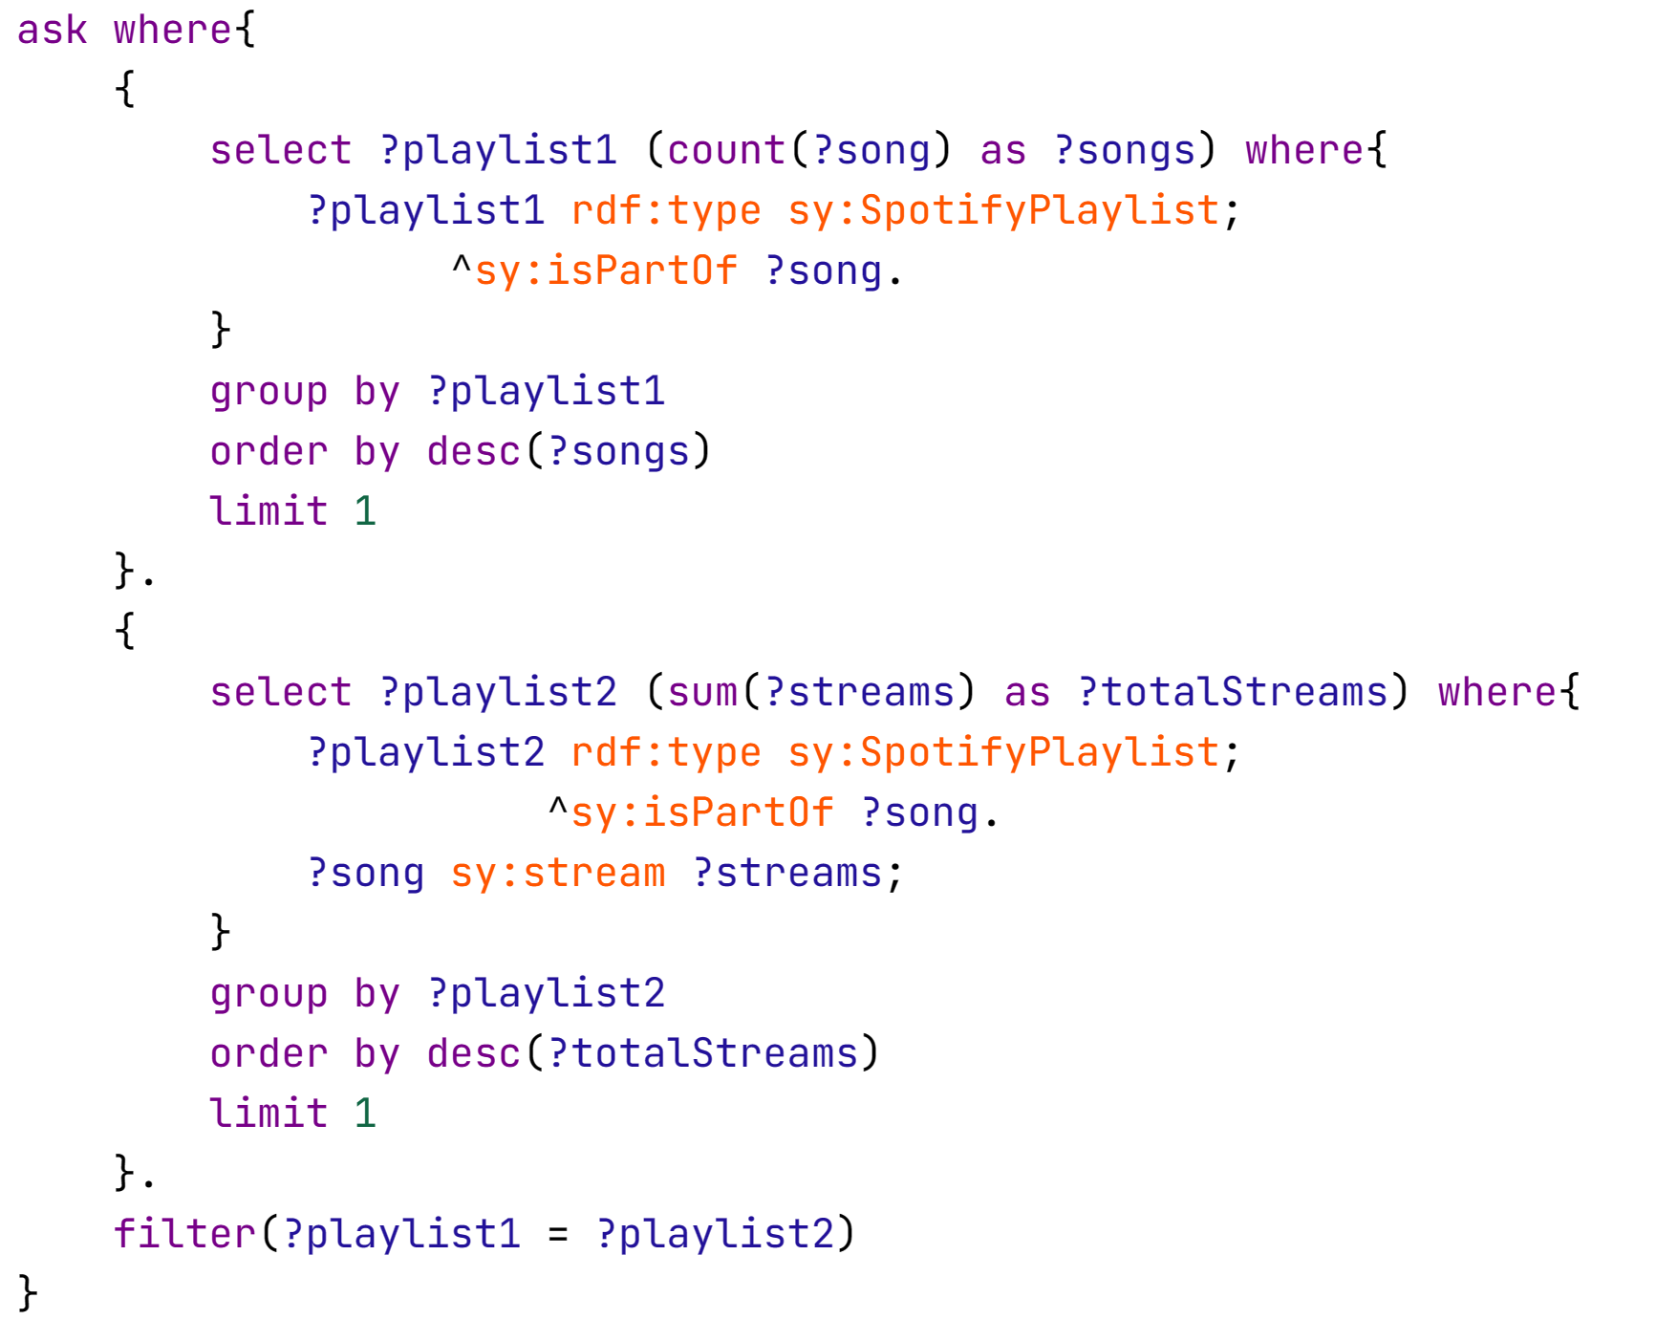

QUERIES (6)
Is the playlist with most songs the one with most streams?
Notes:
Expected, there are songs with very big n of streams

Slide 15
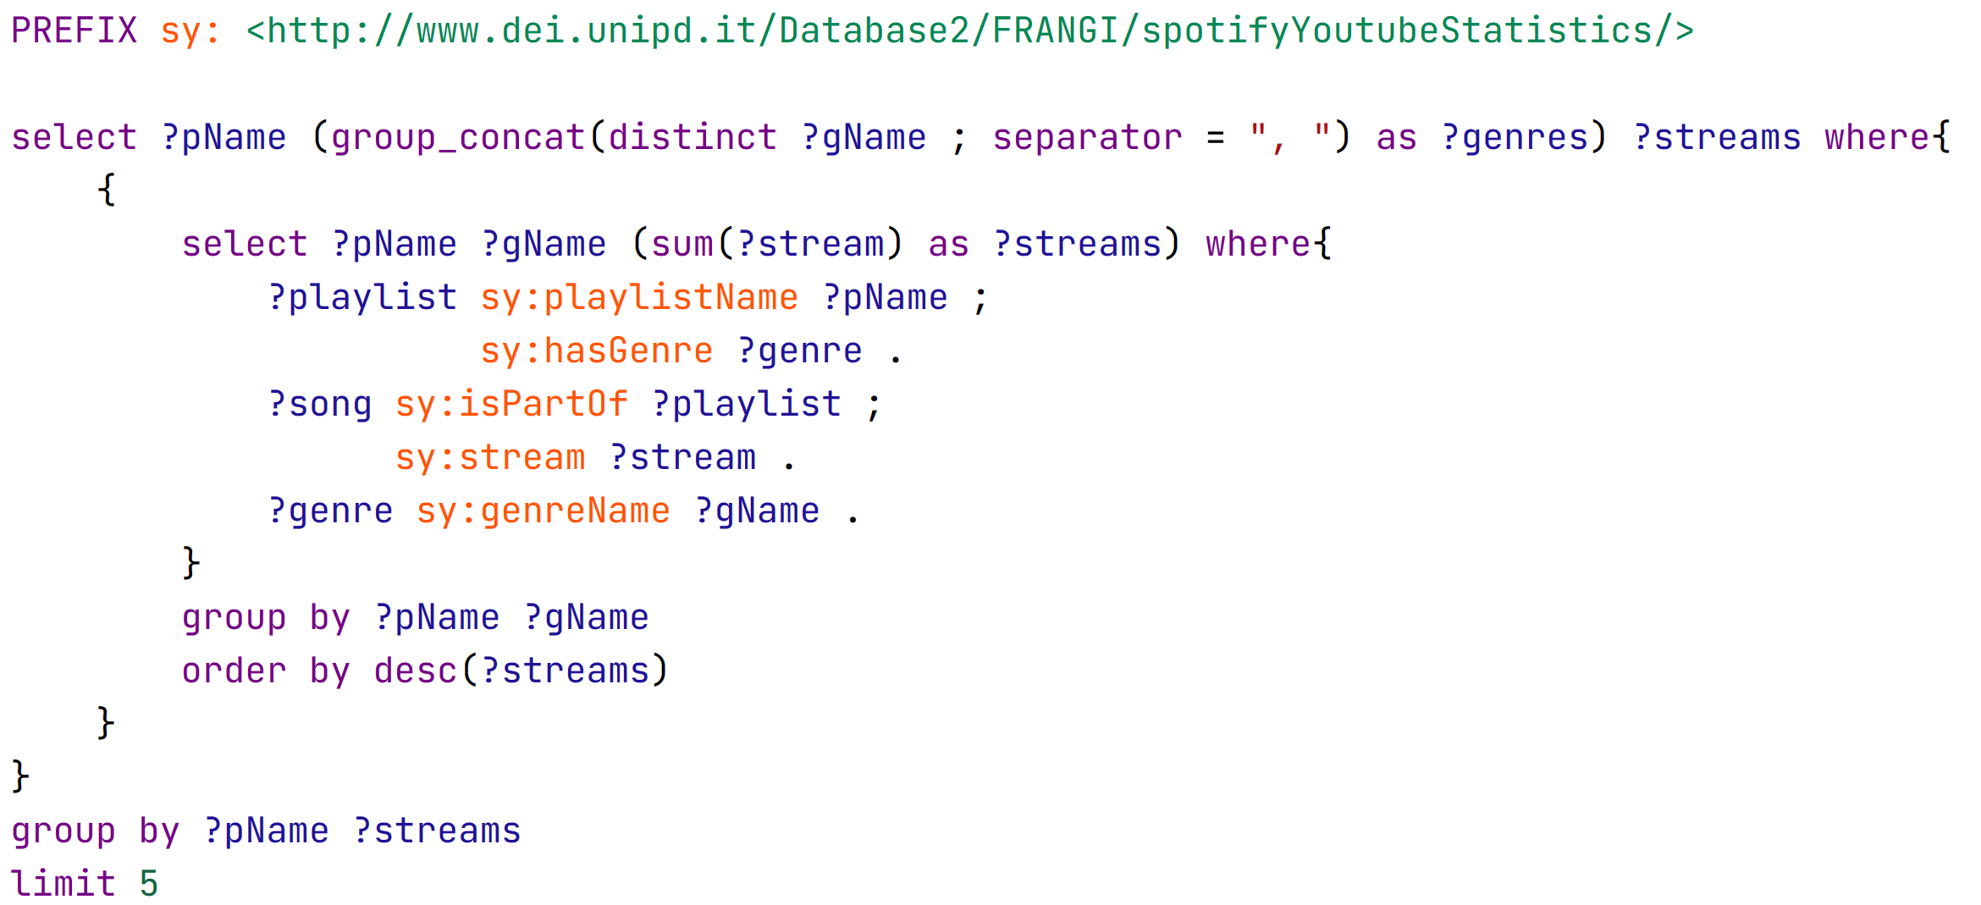
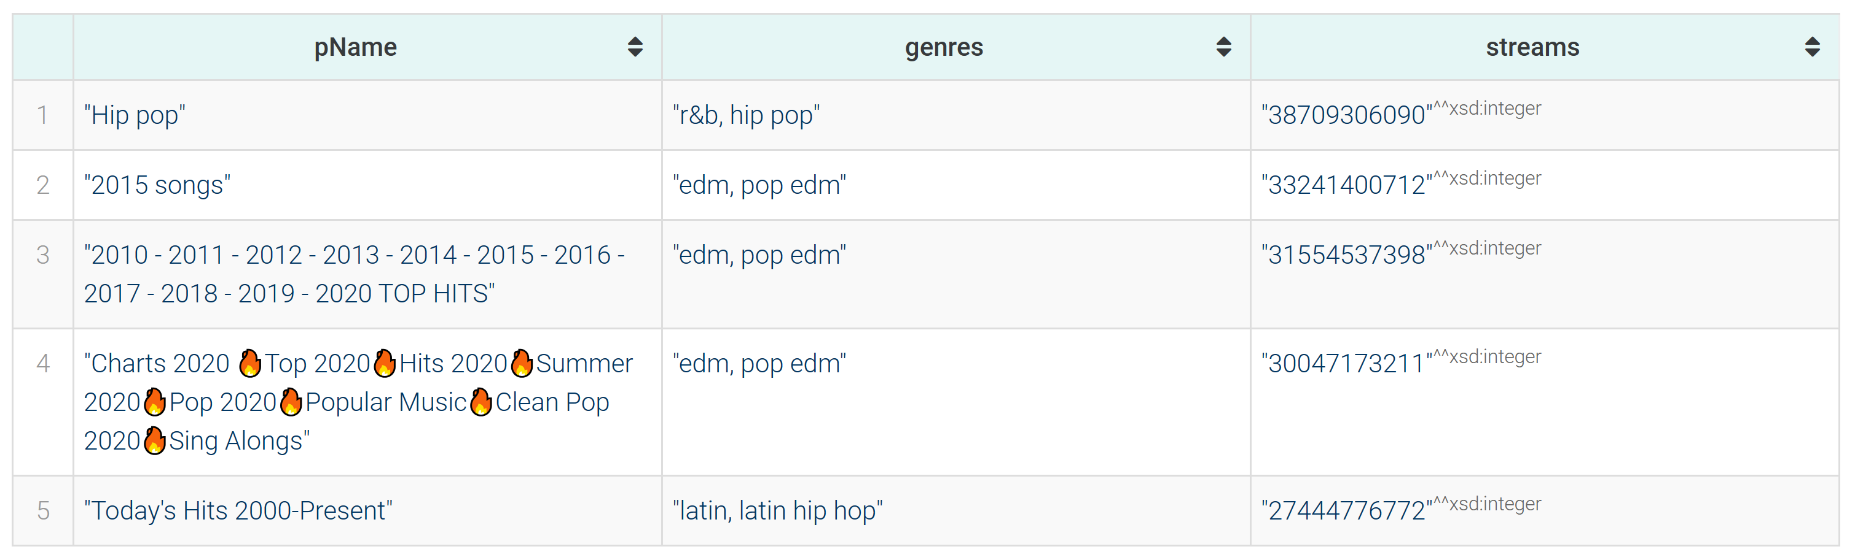
QUERIES (7)
Genre of top 5 playlists with most played songs
Notes:
Shows what people like atm.

Slide 16
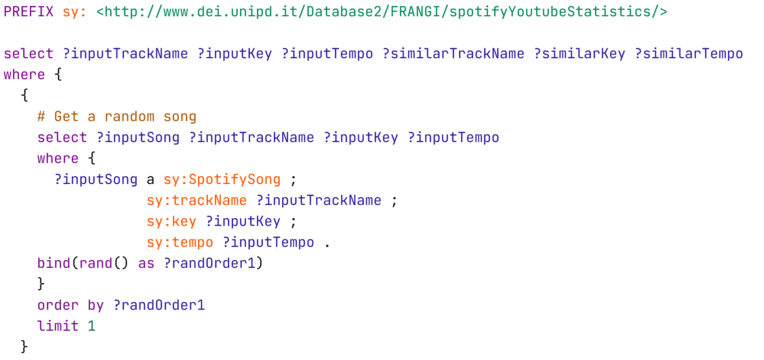
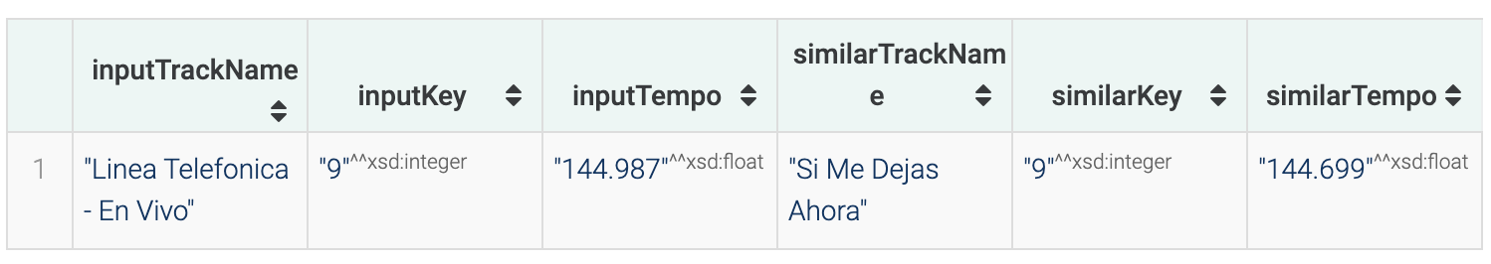
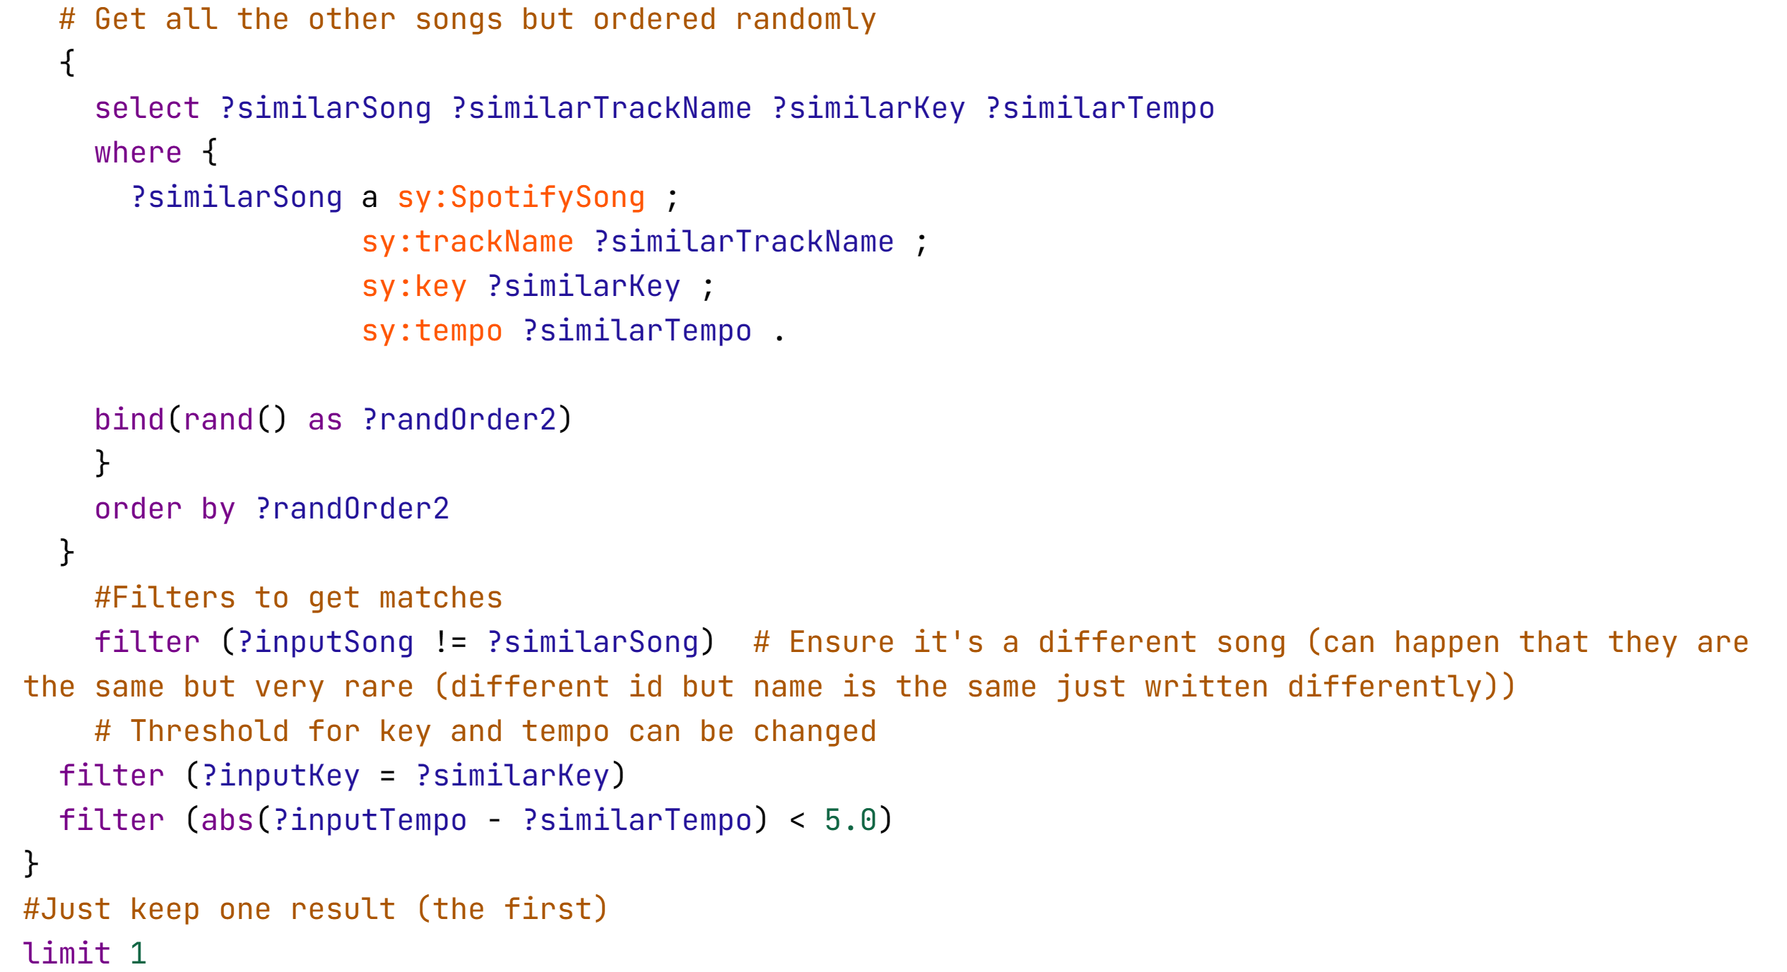
QUERIES (8)
Random pair of songs that have similar tempo and key (useful for DJs)
Notes:
Note the use of random in graphDB, very hard to use, using bind and rand() as random ordering. Can choose threshold of key and tempo similarity.

Slide 17
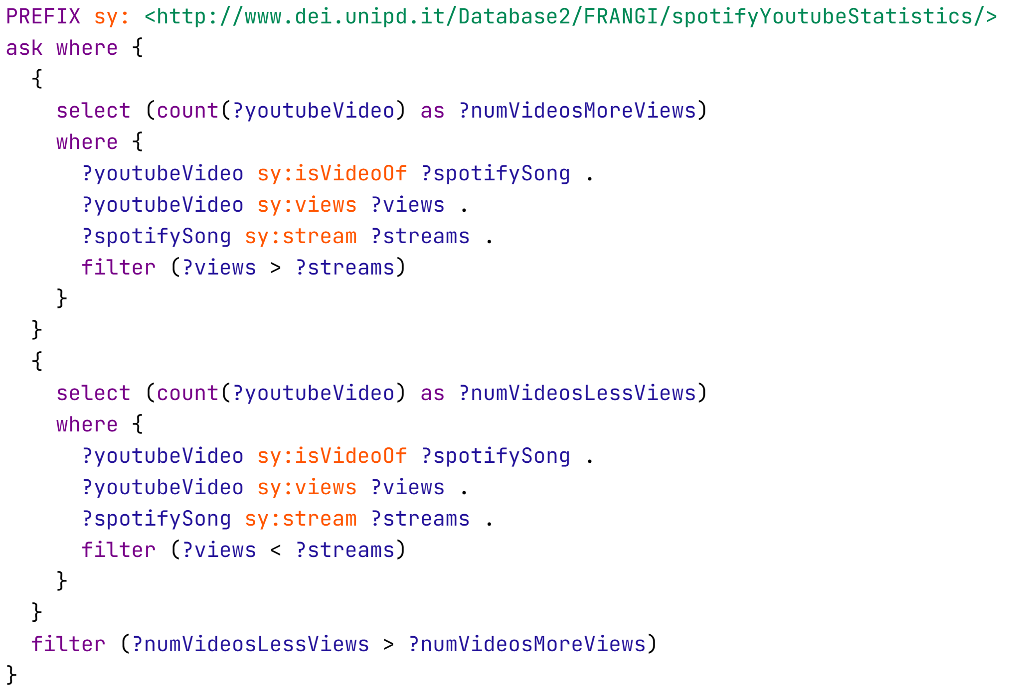

QUERIES (9)
Are number of streams of a song higher than the number of views of their related youtube video (in general)?

Slide 18
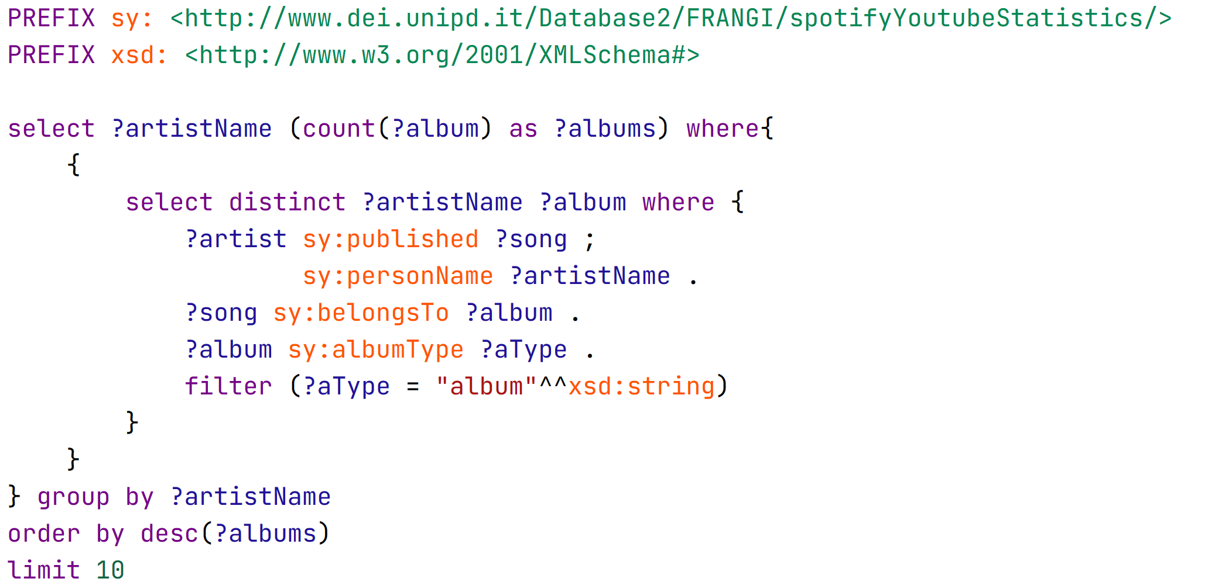
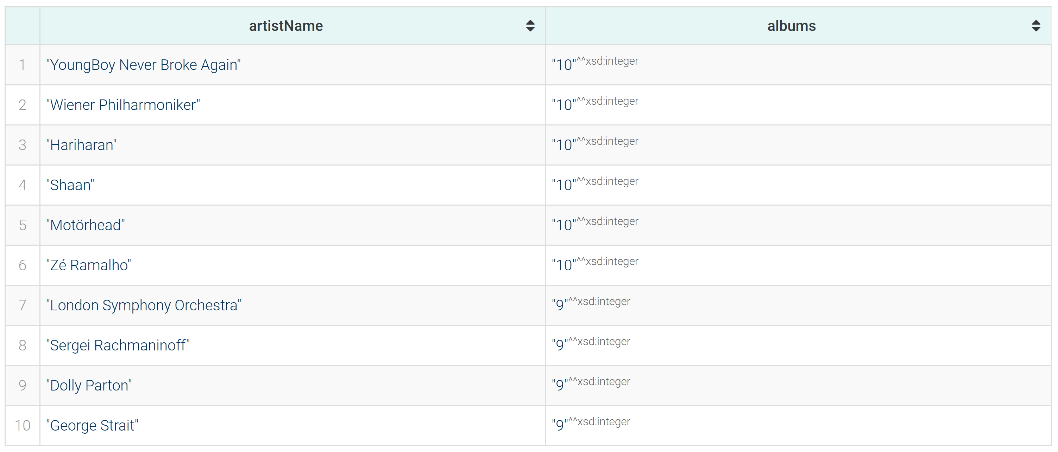
QUERIES (10)
Top 10 artists by number of albums published

Slide 19
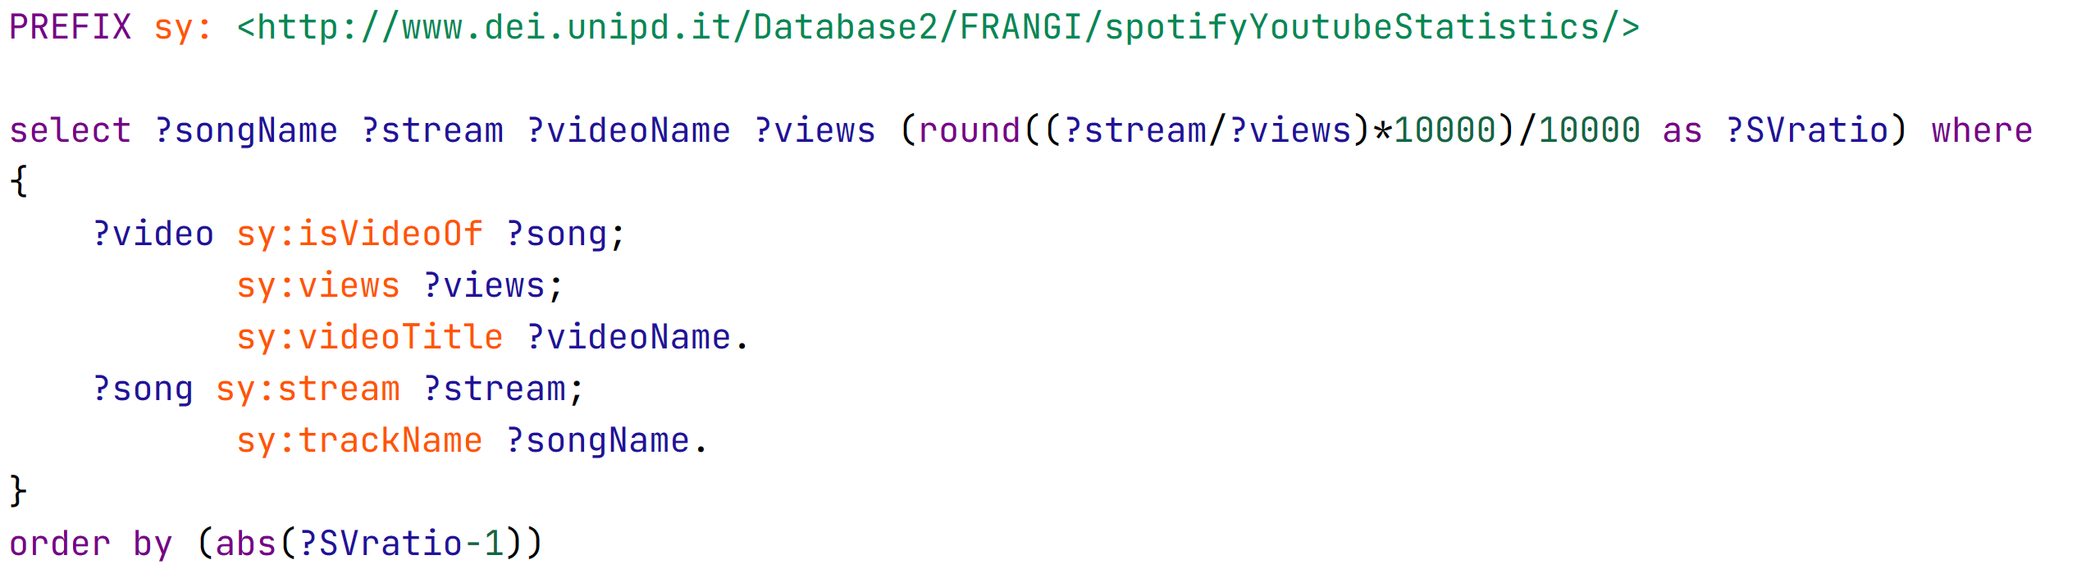
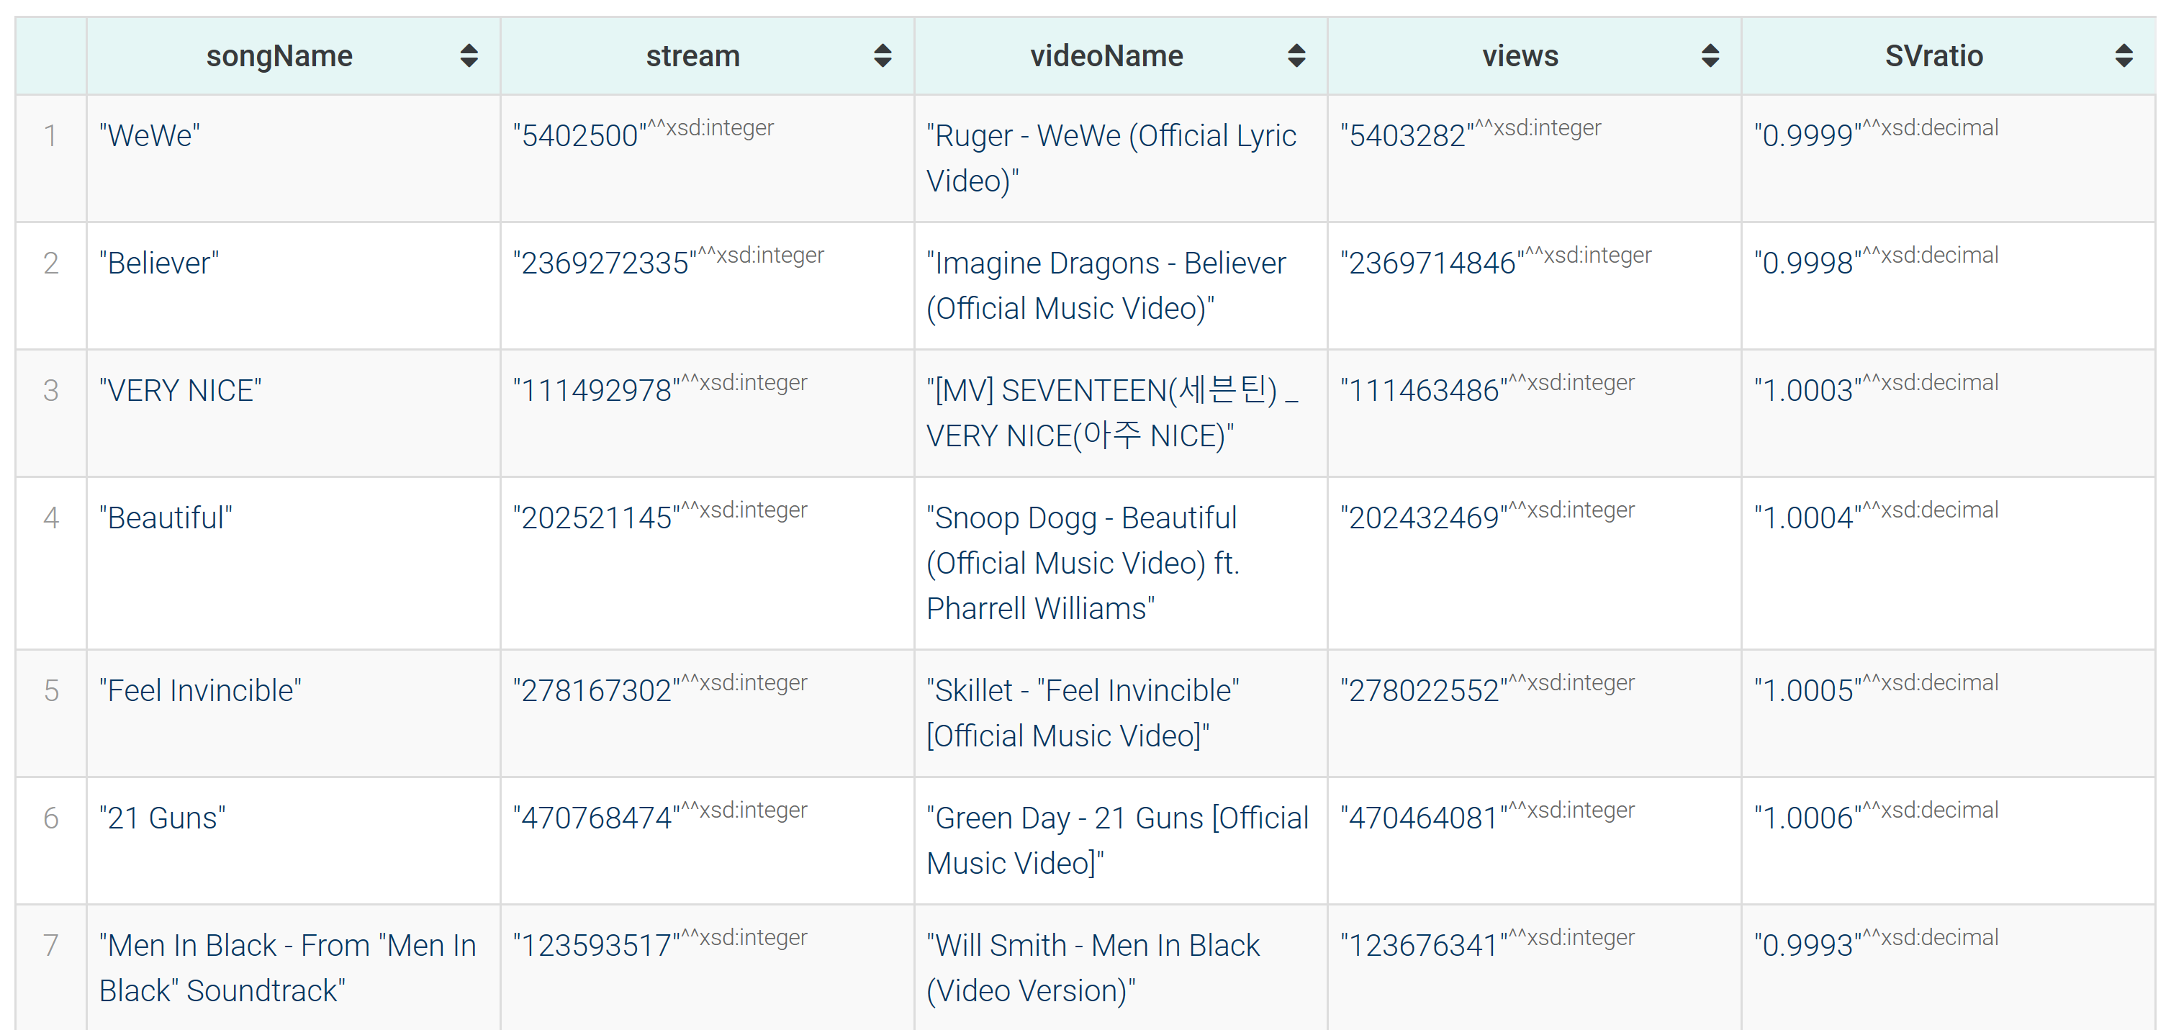
QUERIES (11)
Relation between YouTube video views and corresponding song
Notes:
We found out some songs with similar streams to yt video views. A lot of popular songs have way higher streams than views.

Slide 20
THANKS FOR YOUR ATTENTION!
Francesco Frigato, Andrea Felline, Gianluca Antolini

